Slide 1
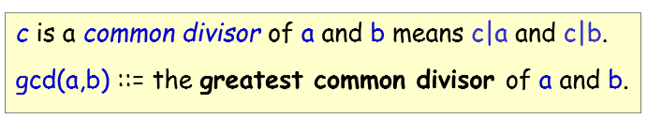
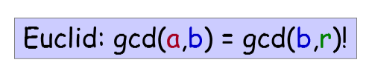
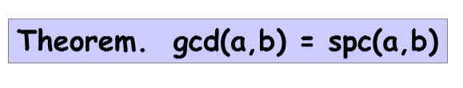

Slide 2
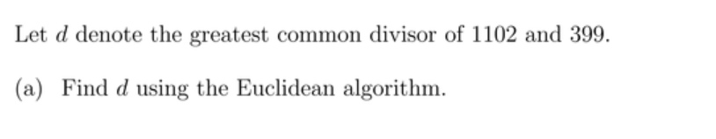

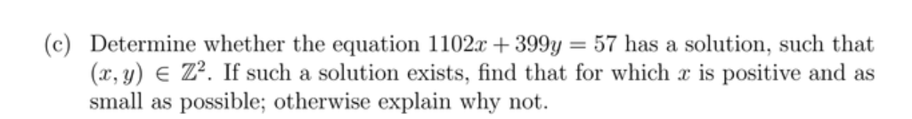

Slide 3
Prove that if gcd(x ,y)=1,then
gcd(x+y ,x-y)=1or2

Slide 4

Suppose n is even and $\gcd\left(m,n\right)=5$,
show that m is odd

Slide 5
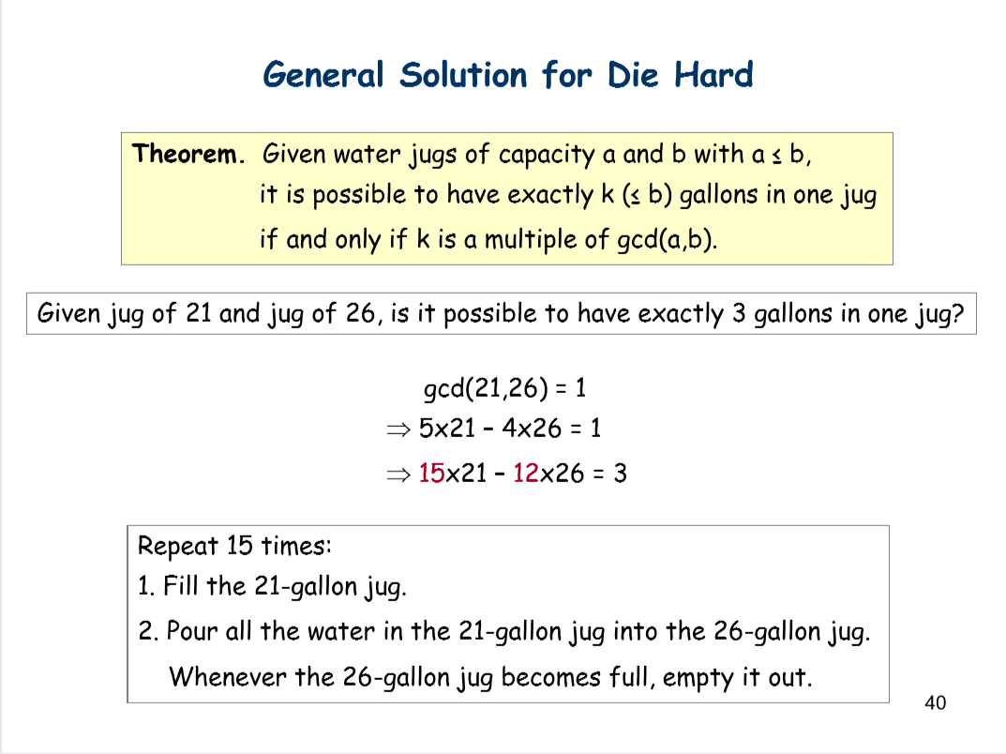

Slide 6
